Slide 1
Maven-Based Java Web Application
AQE TRAINING PROJECT
BY MODHURAI MITRA
(206349)

Slide 2
Table of Contents
Introduction
Application of Maven Project imported into Eclipse IDE
Run as Java Application
Push Project into Github
Successful Jenkins Build
Dockerizing the Application
Build Docker Image & Run Docker Container
Successful Access of Webpage through Docker port
Pushing to DockerHub Repository and Image Pulling

Slide 3
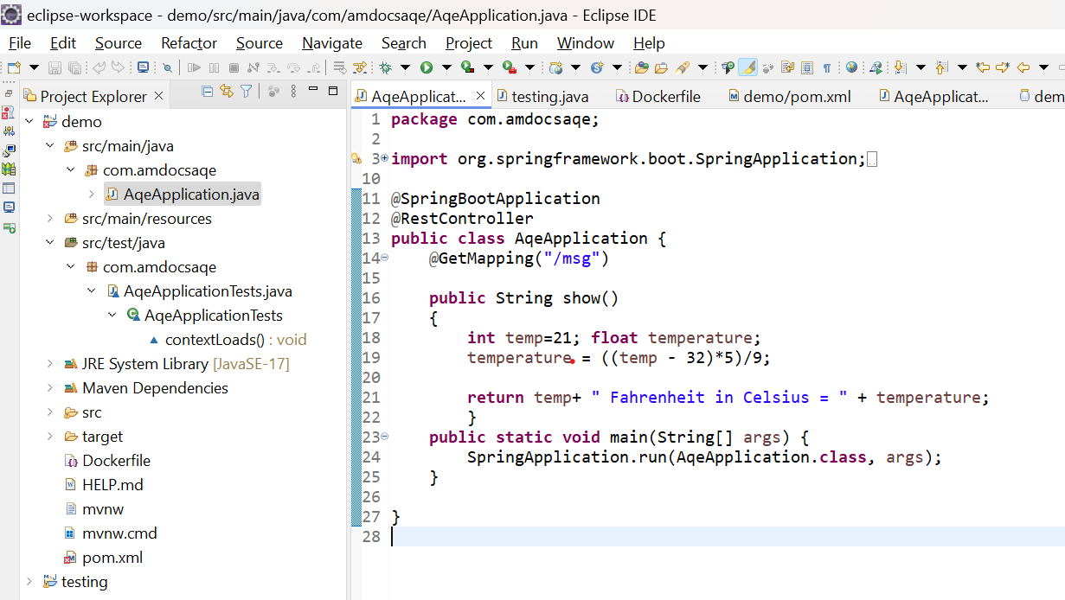
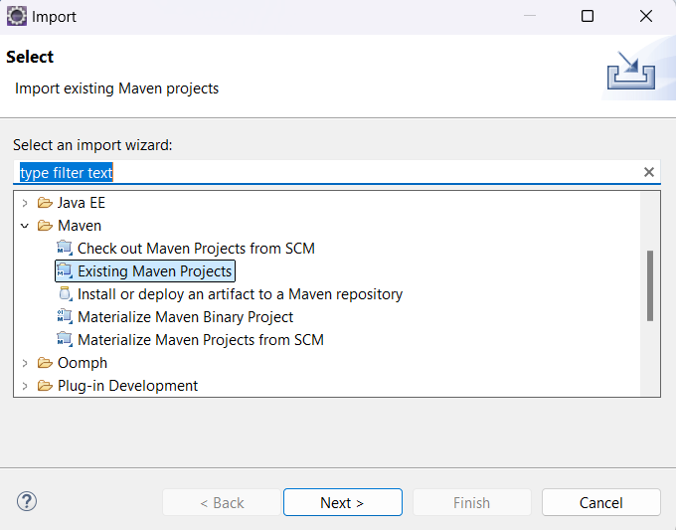

Application of Maven Project imported into Eclipse IDE
Coding in the Java class
Importing Spring Initialiser project, with Spring Web Dependencies, into Eclipse IDE
Assigning Server Port

Slide 4
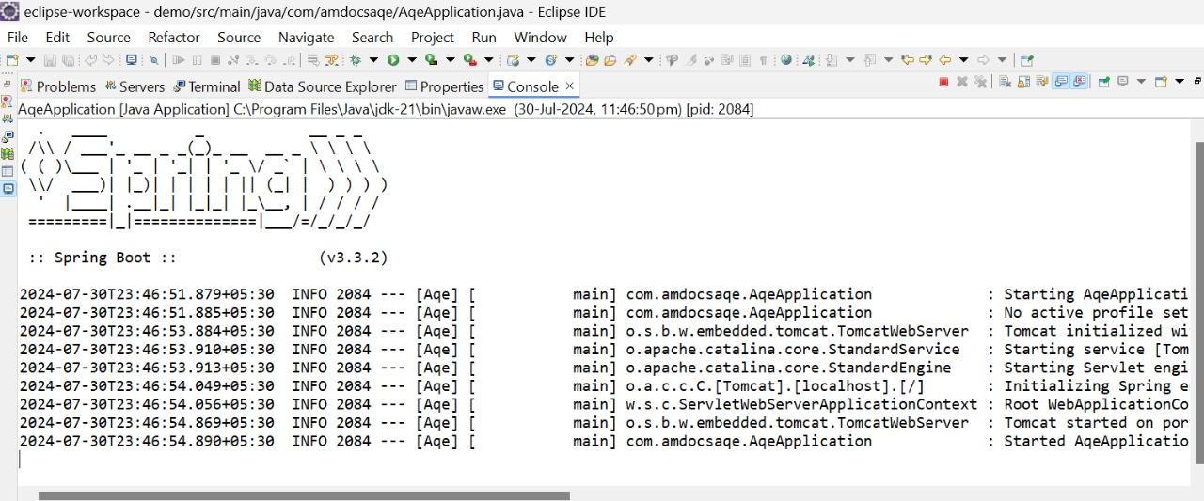
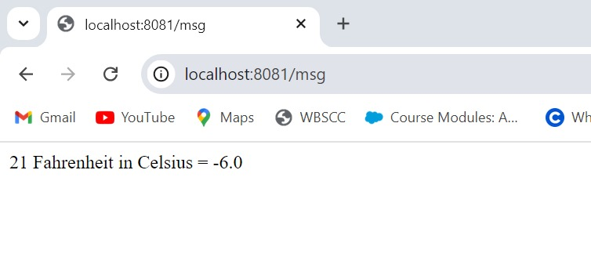
Run as Java Application
Running the project as Java Application
Output of Webpage in server port

Slide 5
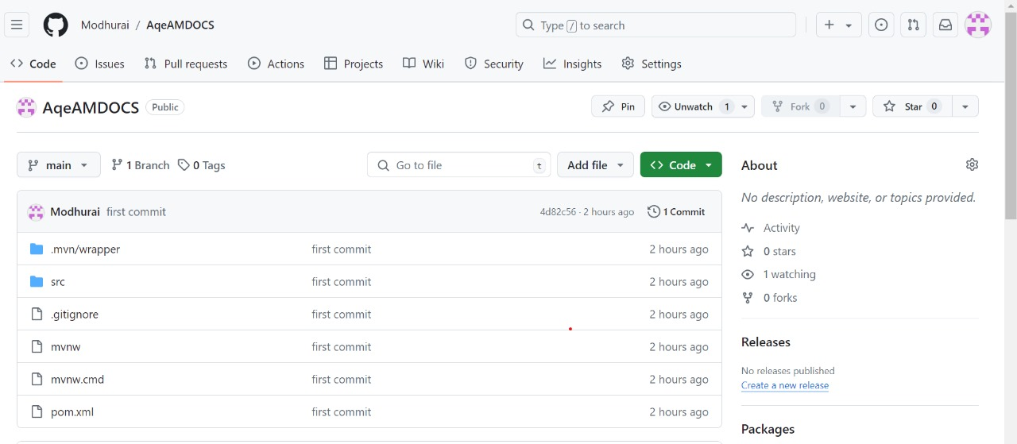
Push Project into GitHub
Follow steps to push into GitHub:
git init
git status
git add . git commit -m "first commit"
git status
git branch -M main
git remote add origin https://github.com/Modhurai/AqeAMDOCS.git
git push -u origin main

Slide 6
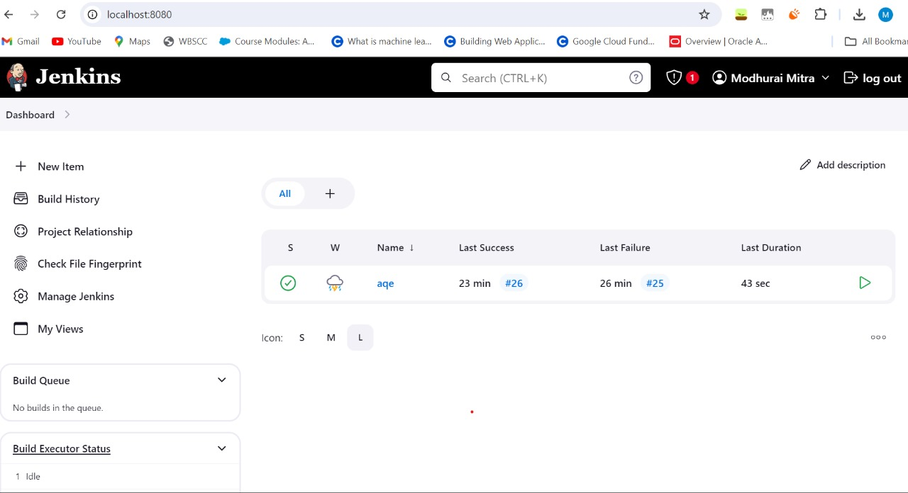
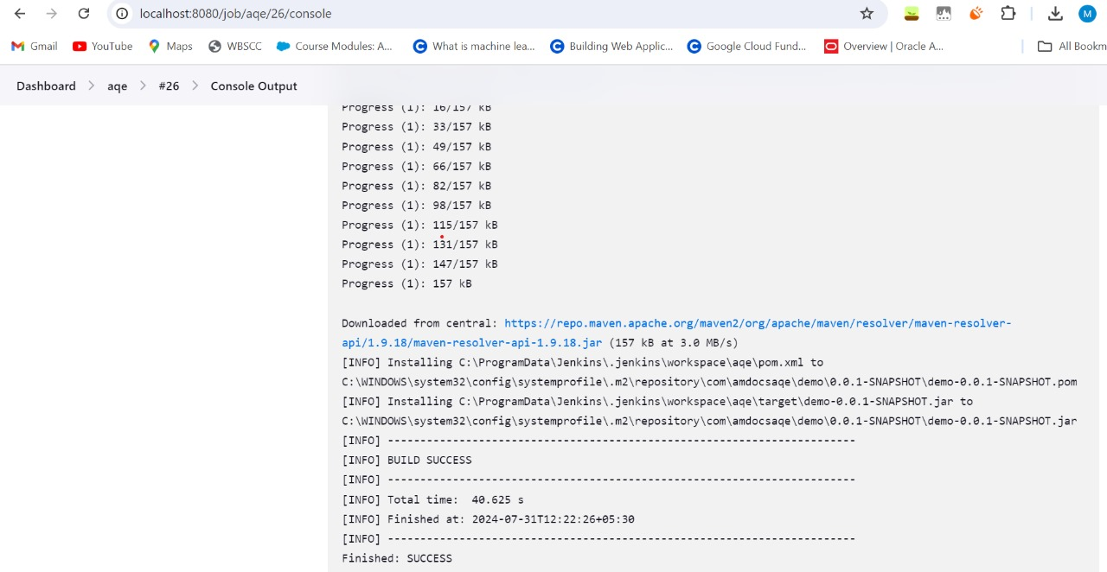
Successful Jenkins Build
Build History>> Console Output
Create new item, save a Freestyle Git Project by linking with GitHub account, select branch, poll scm-schedule(* * * * * ), build steps and install

Slide 7
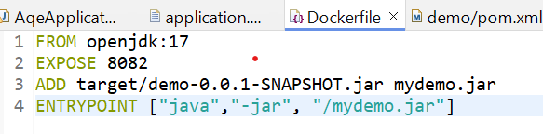
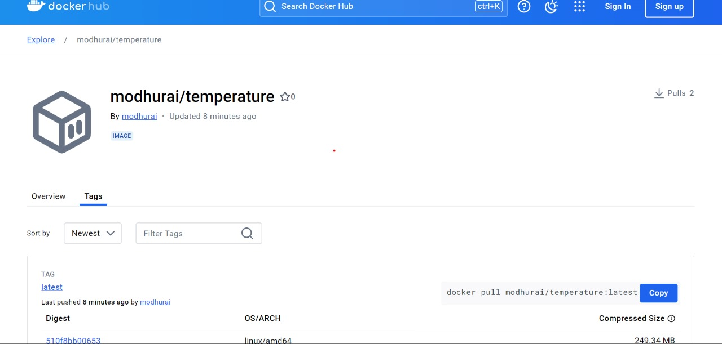
Dockerizing the Application
Create .jar file by running as Maven install
Create new file and name it Dockerfile (Case-Sensitive)
In Dockerfile, enter code

Slide 8
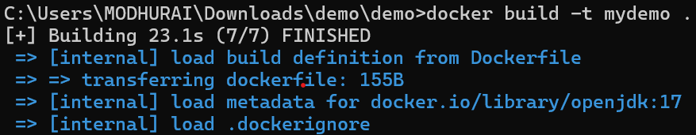
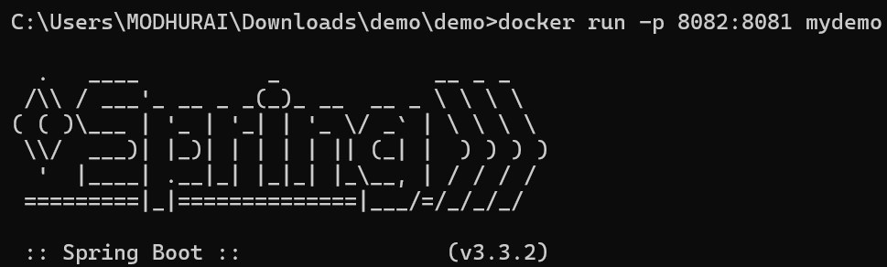
Build Docker Image & Run Docker Container
Build docker
Run Docker Port

Slide 9
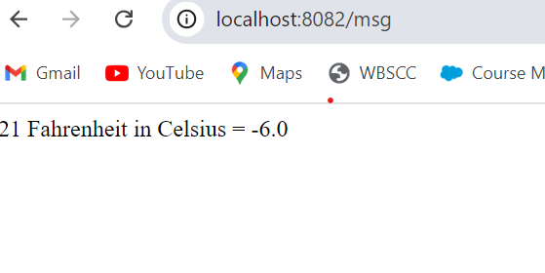
Successful Access of Webpage through Docker Port

Slide 10
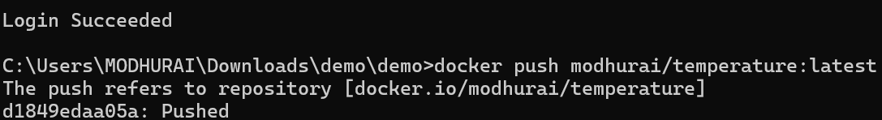
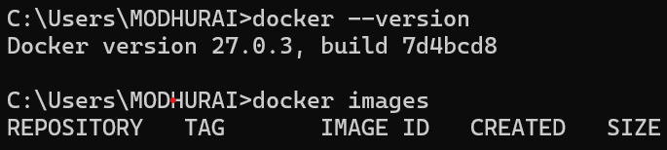
Pushing to DockerHub Repository and Image Pulling
Create Docker Repository
Tag image to repository
Push docker image
Check creation
Pull Docker image

Slide 11
Thank you
MODHURAI MITRA
EMPLOYEE ID: 206349

